Slide 1
Valuable screen shots

Slide 2
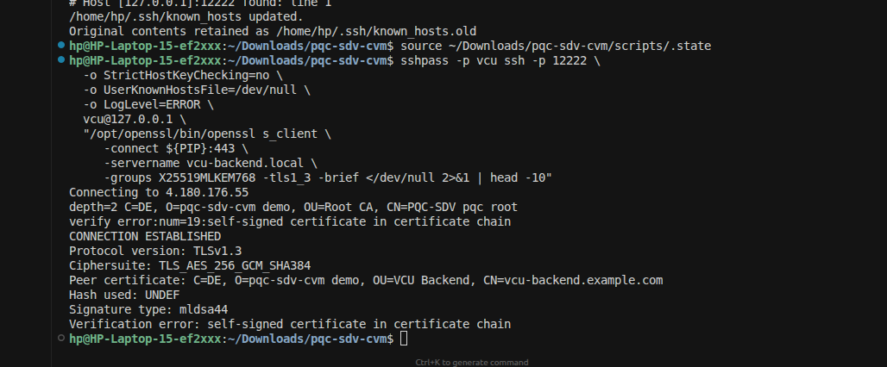

Slide 3
